Slide 1
CORONA VIRUS ANALYSIS
COVID-19 SQL Analysis(2020 & 2021)
BY BLESSING ENE OTACHE
BATCH NAME: MIP-DA-09

Slide 2


Introduction Objective Problem Statement Dataset Overview Dataset Explanation Data Exploration Using SQL Conclusion
TABLE OF CONTENT

Slide 3
INTRODUCTION
Overview
Coronavirus disease (COVID-19) was known in 2019 in Wuhan, China. This communicable disease is caused by the SARS-CoV-2 virus which is usually accompanied with mild to severe respiratory symptoms like fever, cough and difficulty breathing.
The CORONA VIRUS pandemic has had a significant impact on public health and has created an urgent need for data-driven insights to understand the spread of the virus.

Slide 4
Objective
To answer questions by analyzing the CORONA VIRUS dataset using SQL queries and data analysis skills that will derive meaningful insights and present findings into the pandemic's impact.

Slide 5
PROBLEM STATEMENT
The CORONA VIRUS pandemic has had a significant impact on public health and has created an urgent need for data-driven insights to understand the spread of the virus. The key insights of its globally spread will be display using SQL analysis.

Slide 6
DATASET OVERVIEW
COVID-19 dataset contains large information about the spread of this pandemic indicating the data set attributes; Province, Country/Region, Latitude, Longitude, Date, Confirmed, Deaths, Recovered

Slide 7
DATASET EXPLANATION
Description of each column in dataset:
Province: Geographic subdivision within a country/region.
Country/Region: Geographic entity where data is recorded.
Latitude: North-south position on Earth's surface.
Longitude: East-west position on Earth's surface.
Date: Recorded date of CORONA VIRUS data.
Confirmed: Number of diagnosed CORONA VIRUS cases.
Deaths: Number of CORONA VIRUS related deaths.
Recovered: Number of recovered CORONA VIRUS cases

Slide 8
DATA EXPLORATION USING SQL

Slide 9
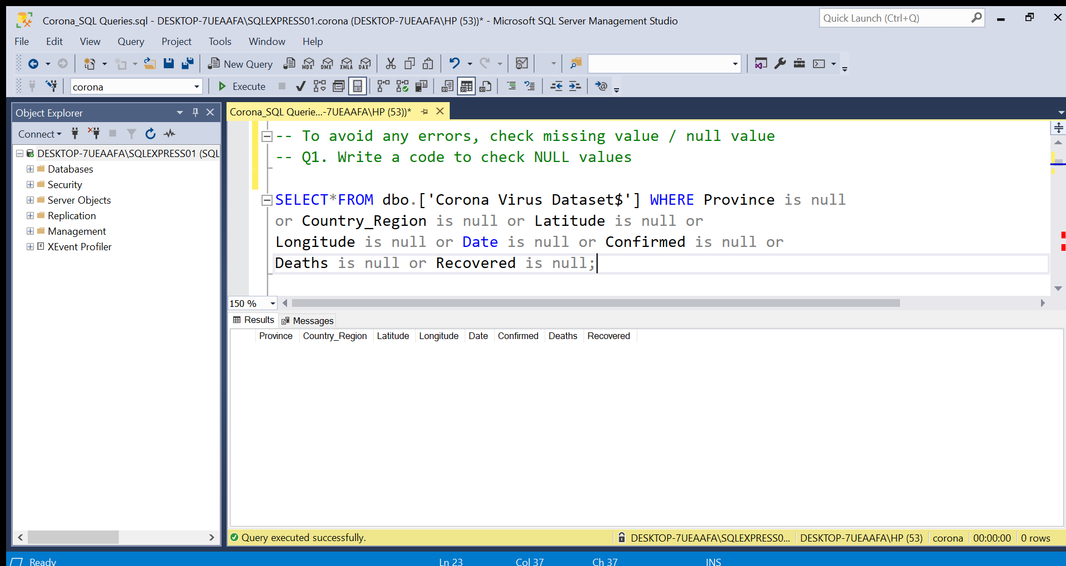
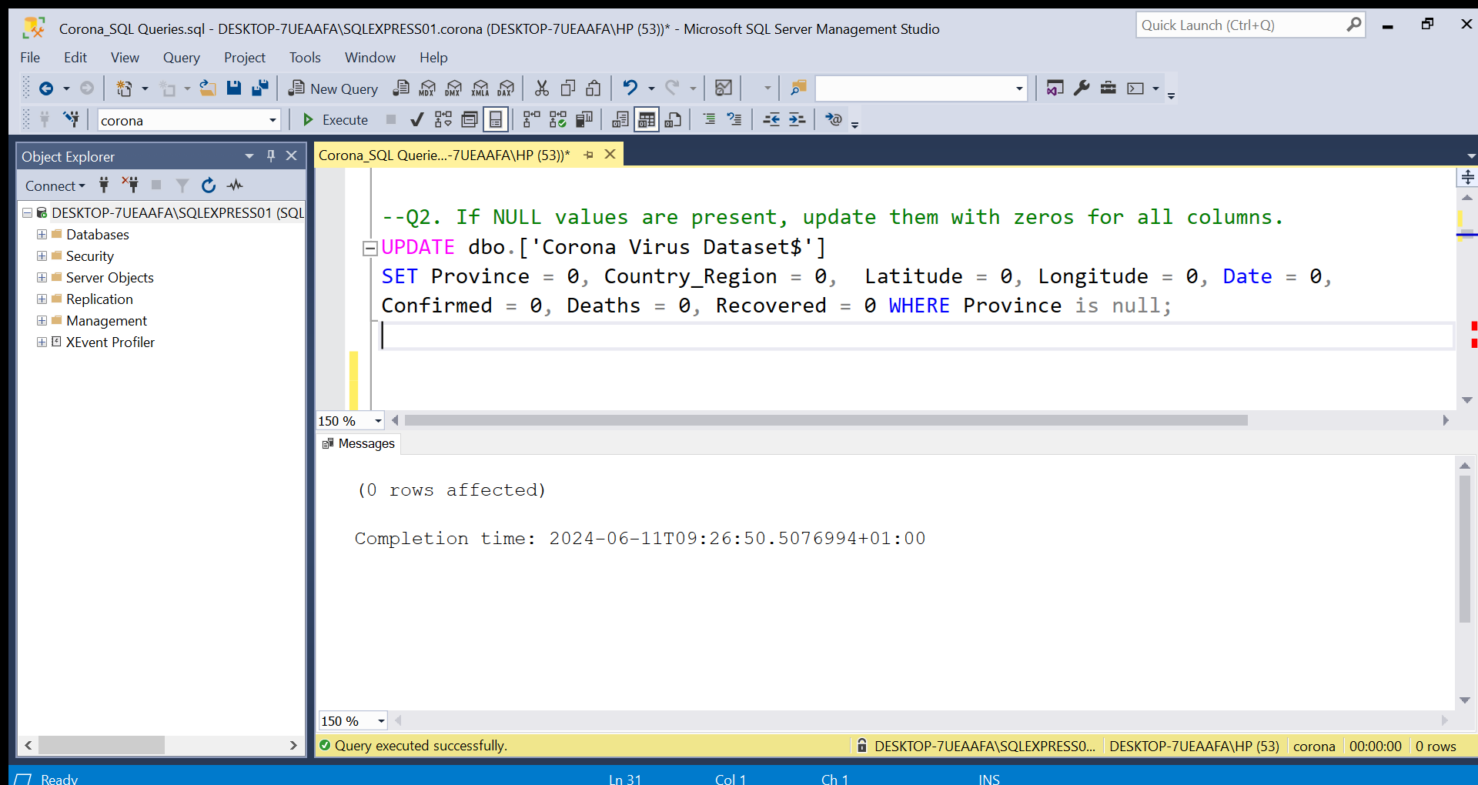
Update Null Values With 0 For All Columns
Check Null Values

Slide 10
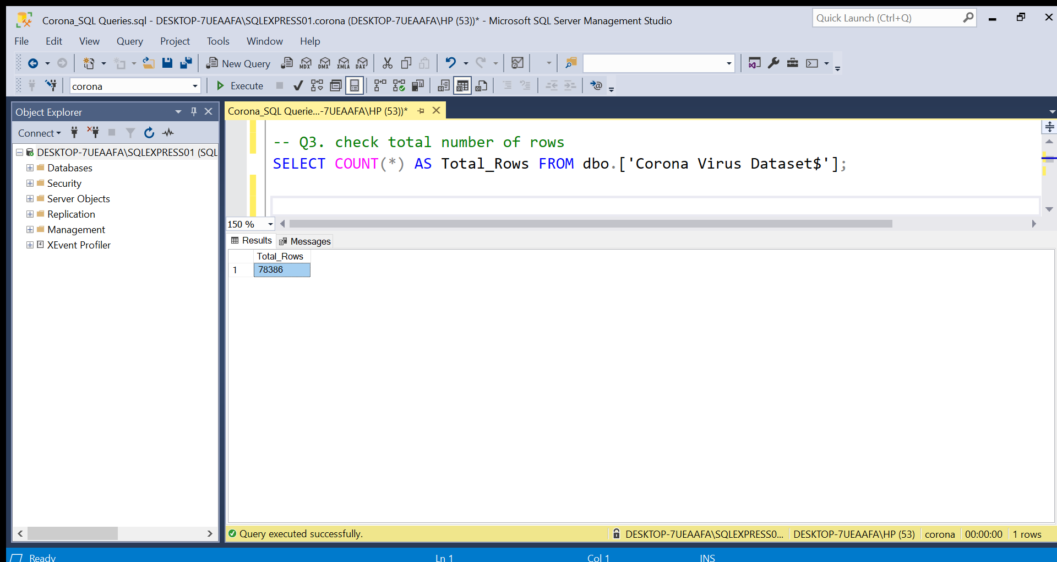
Total Number of Rows
Total Number of Rows = 78386

Slide 11
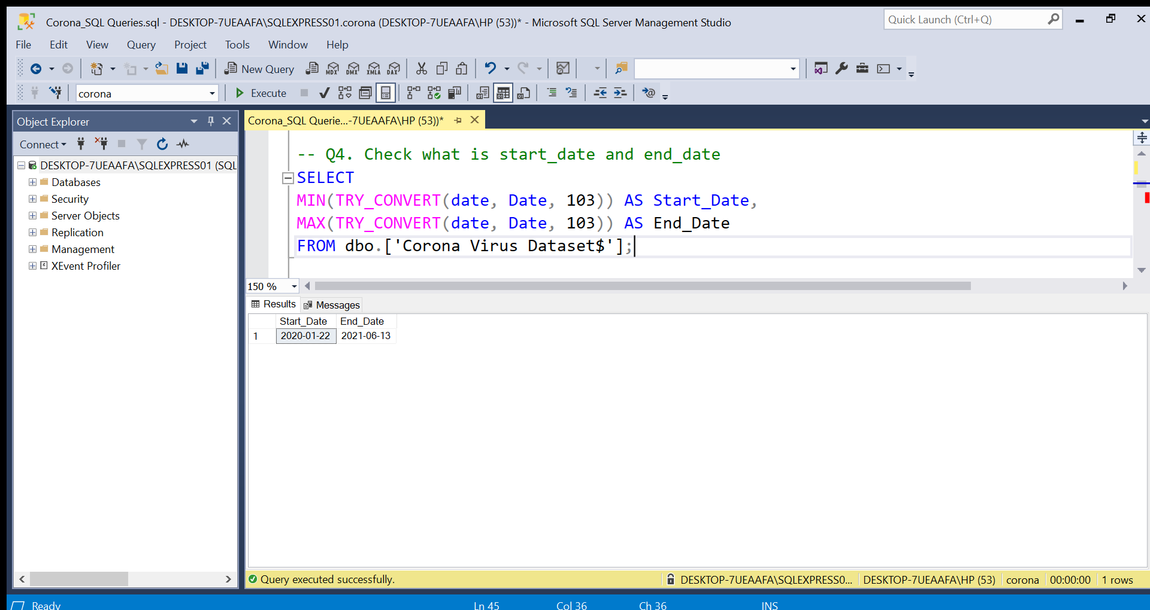
Start and End Date

Slide 12
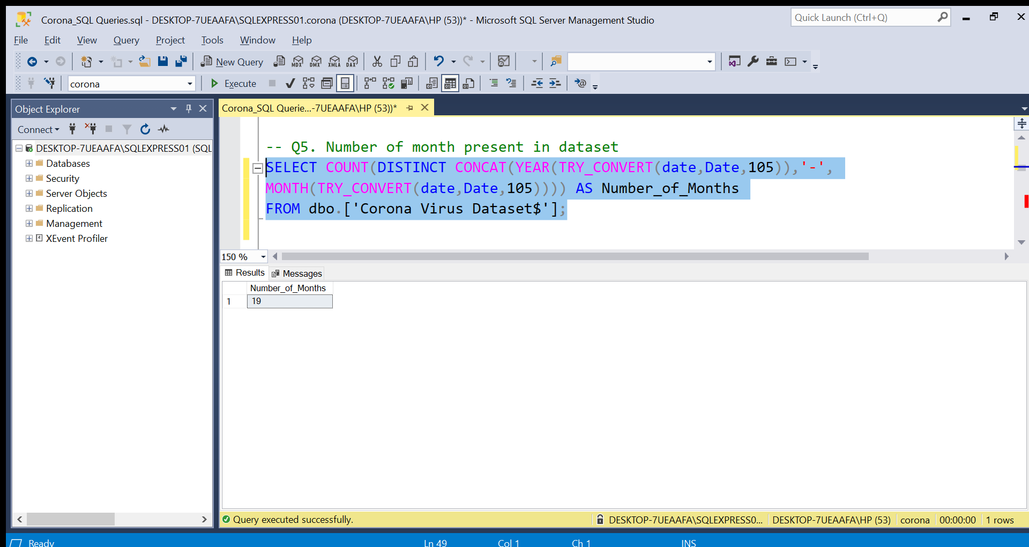
Number Of Month Present In Dataset

Slide 13
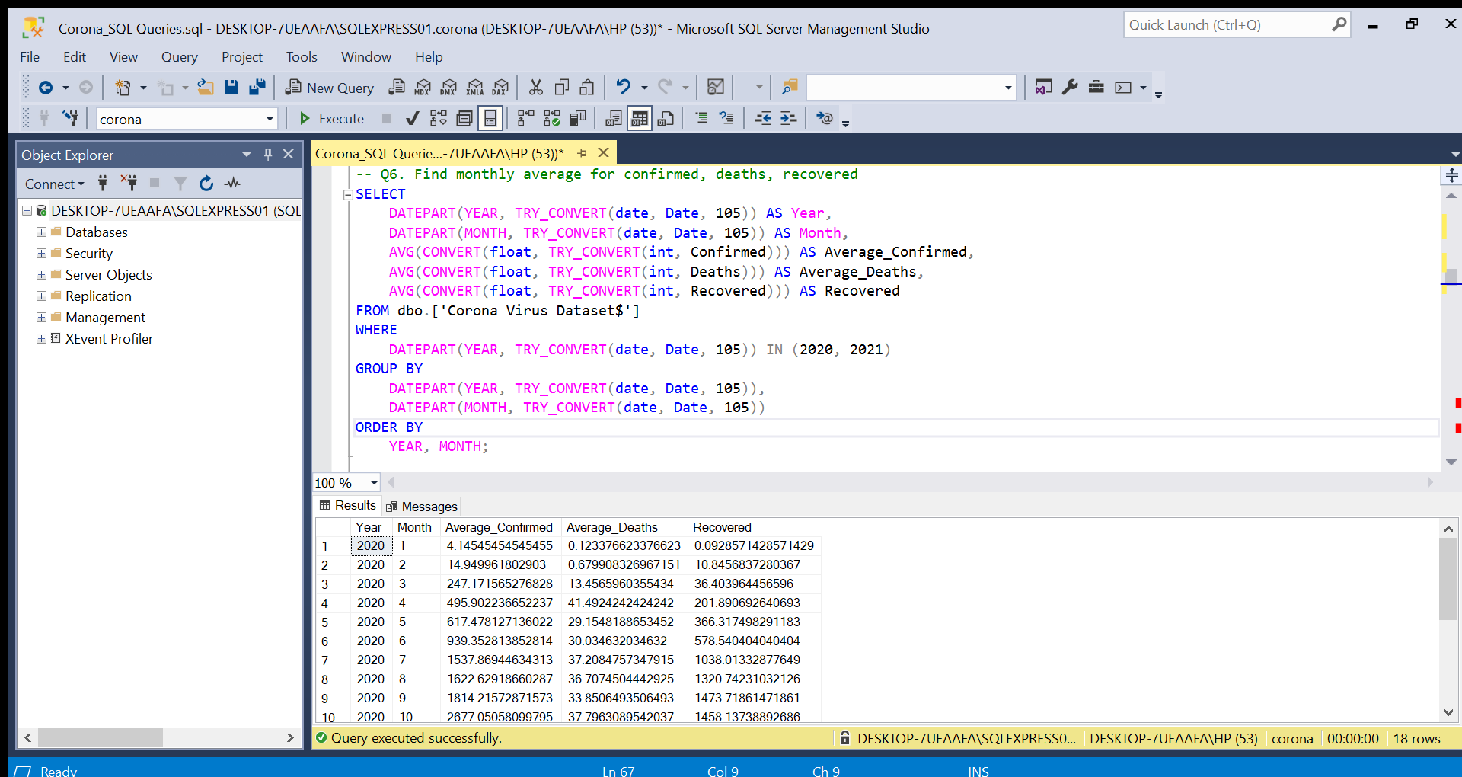
Monthly Average For Confirmed, Deaths, Recovered

Slide 14
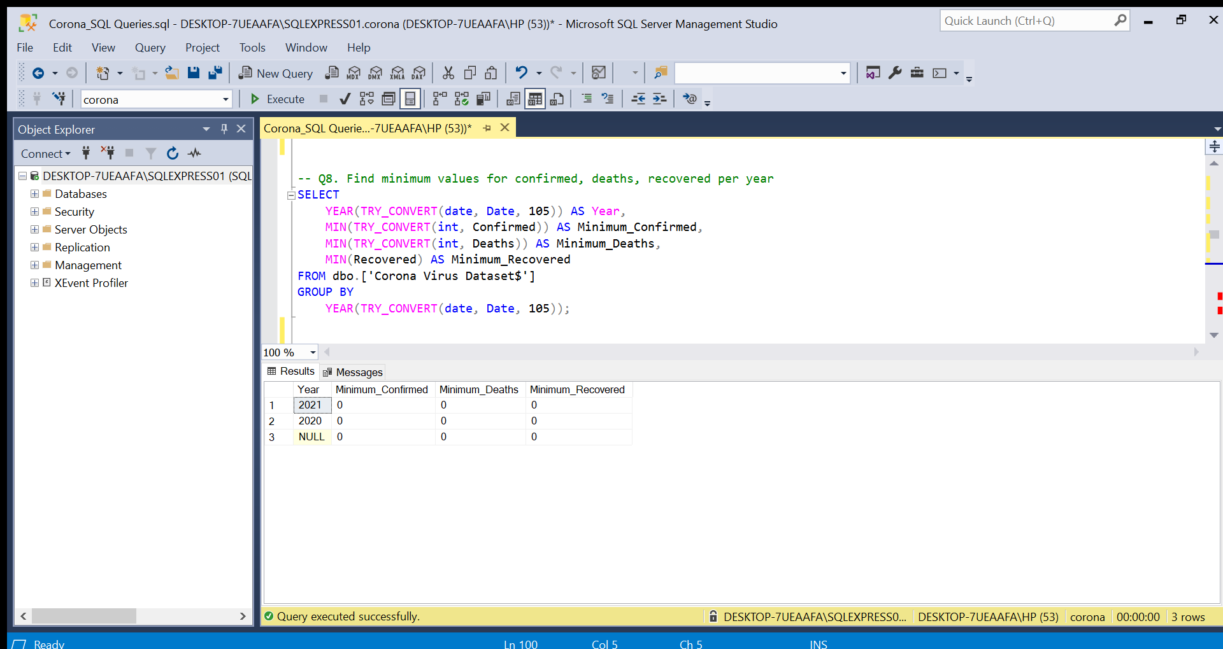
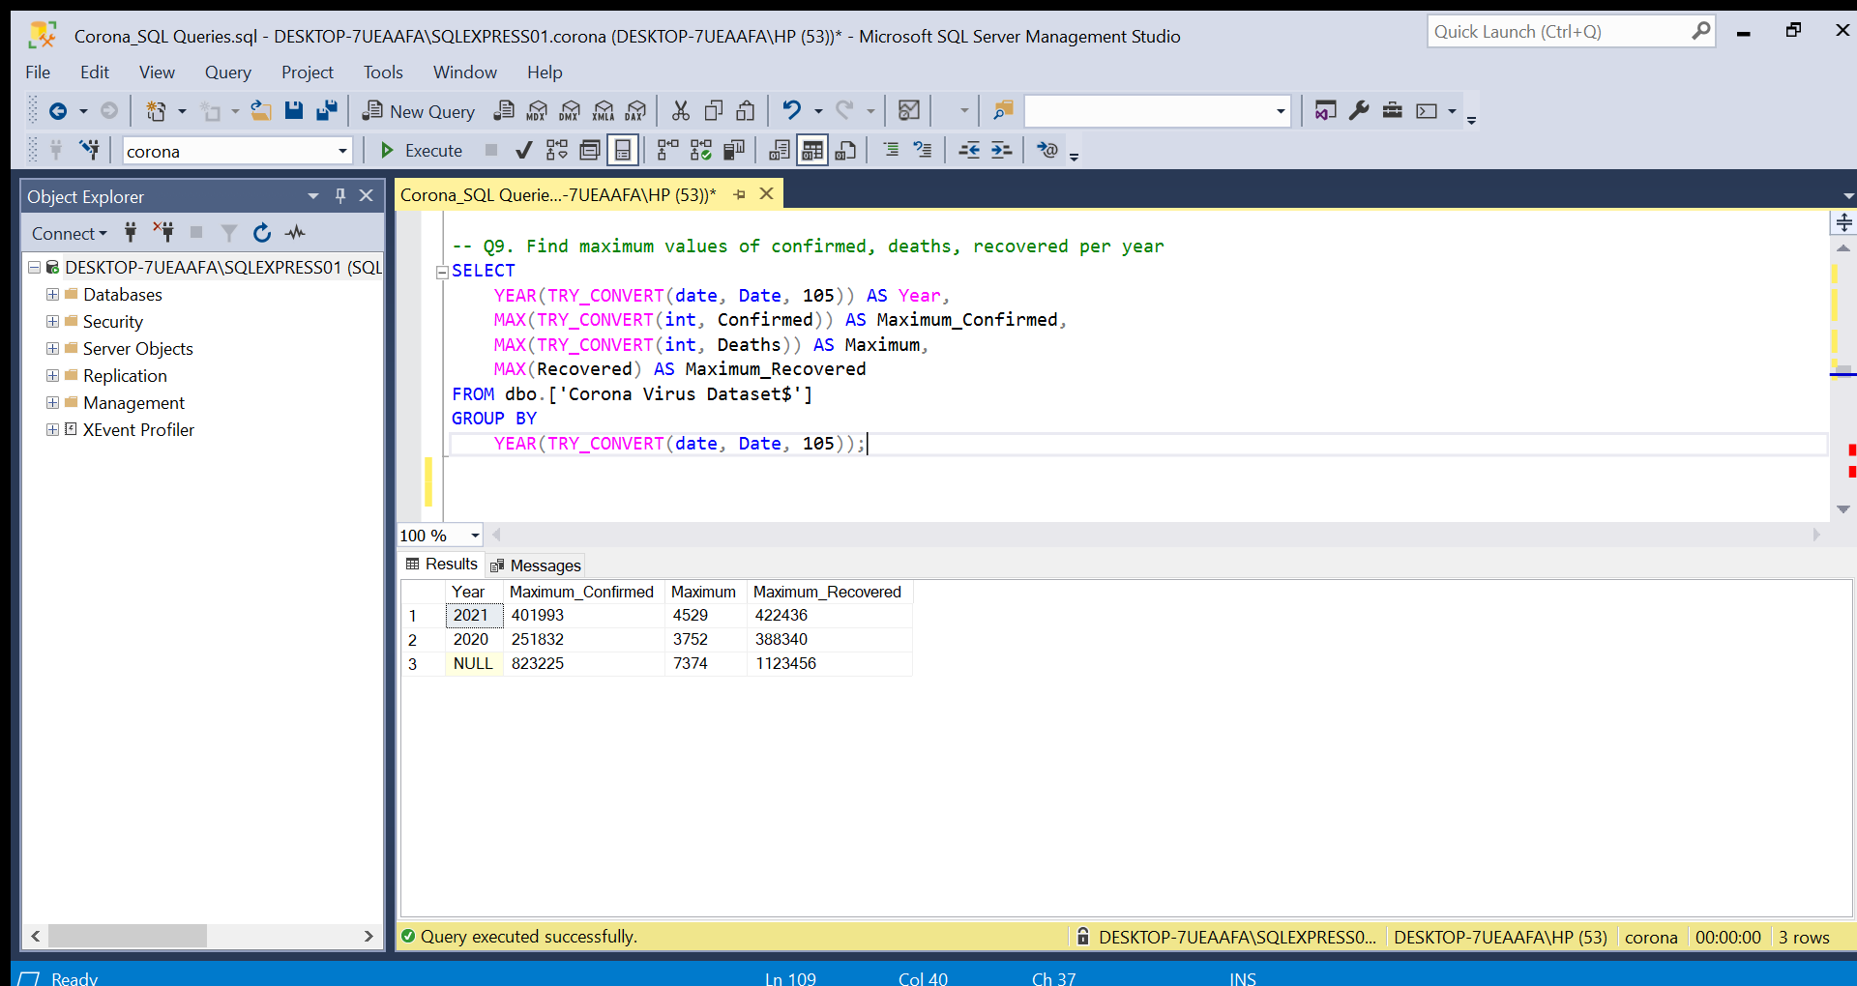
Maximum Values Of Confirmed, Deaths, Recovered Per Year
Minimum Values For Confirmed, Deaths, Recovered Per Year

Slide 15
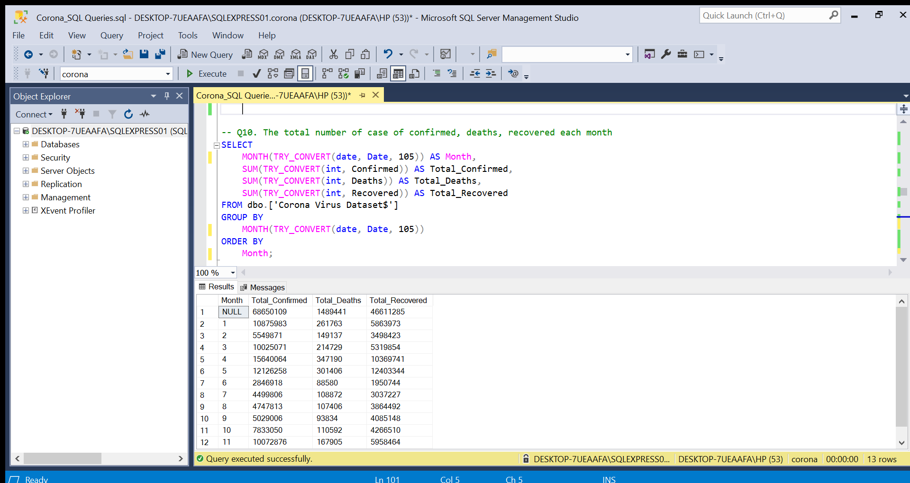
Total Number Of Case Of Confirmed, Deaths, Recovered Each Month

Slide 16
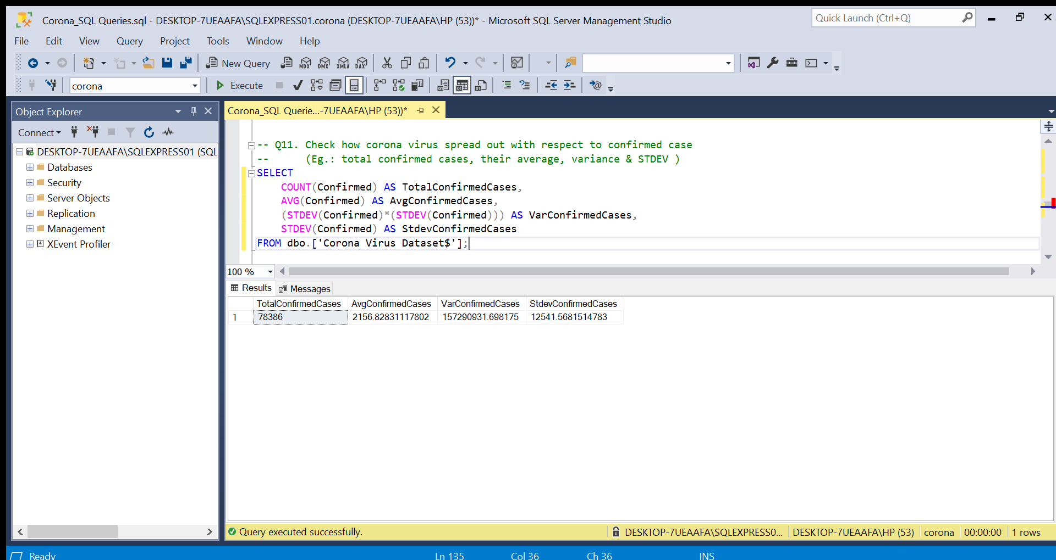
Corona Virus Spread Out With Respect To Confirmed Case

Slide 17
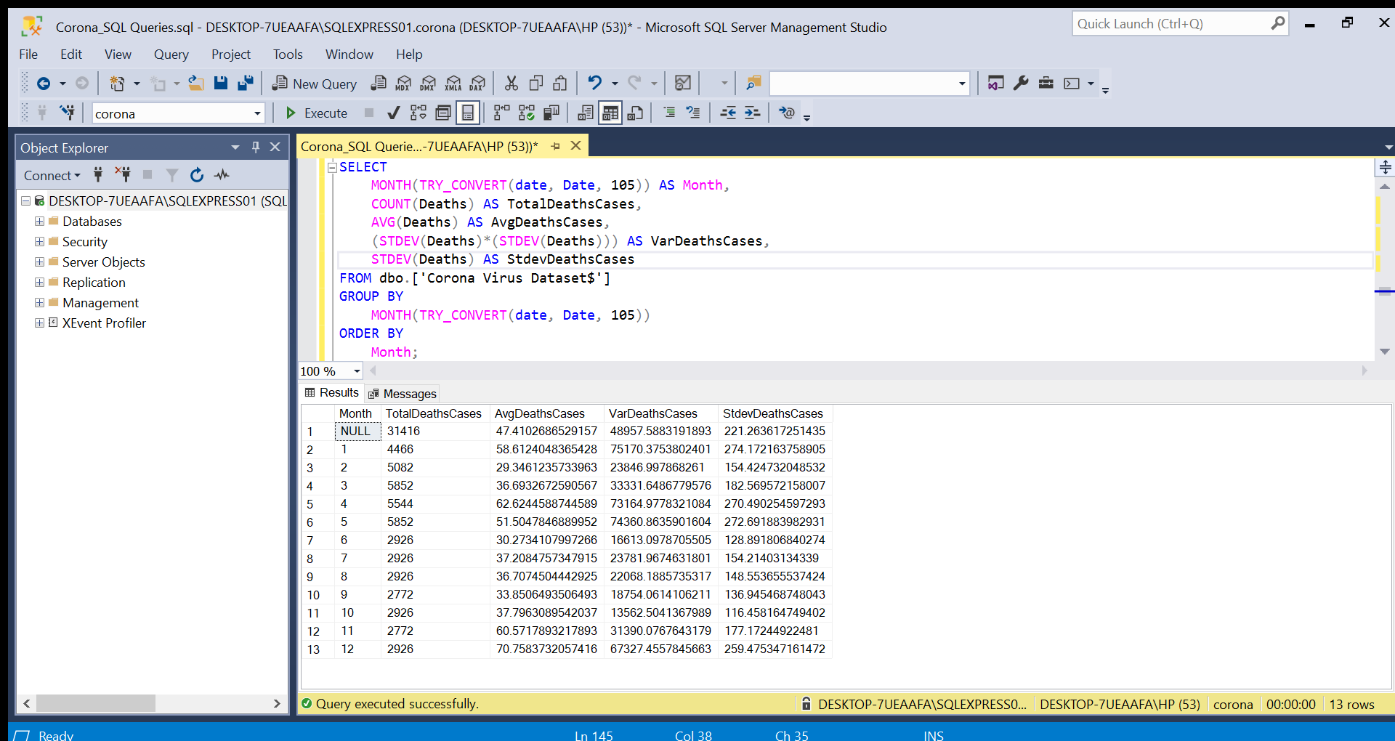
Corona Virus Spread Out With Respect To Death Case Per Month

Slide 18
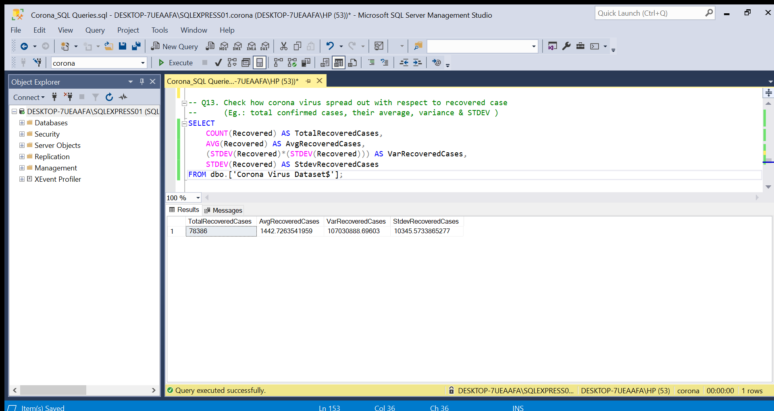
Corona Virus Spread Out With Respect To Recovered Case

Slide 19
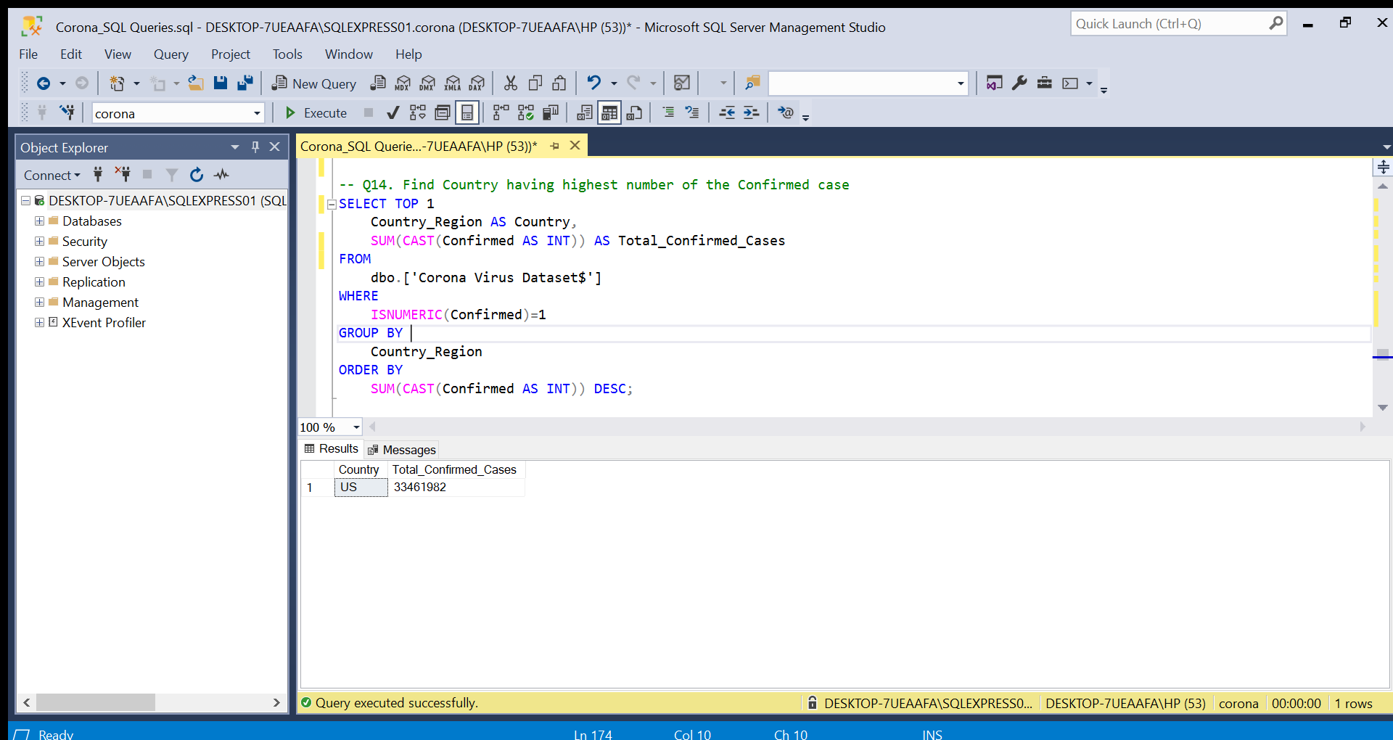
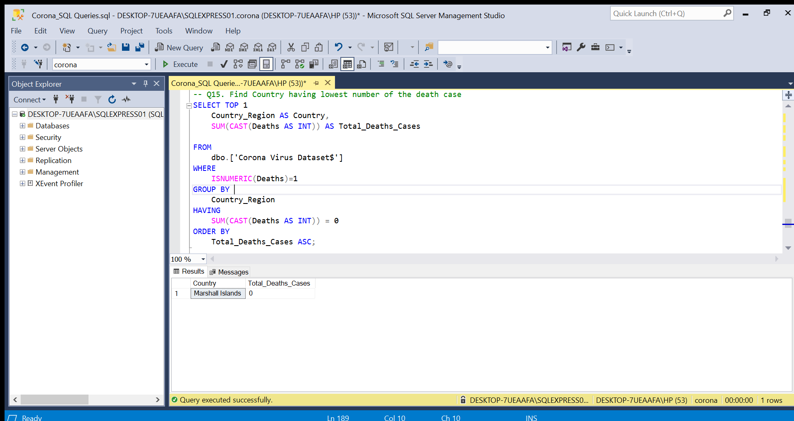
US
Country Having Highest Number Of The Confirmed Case
Country Having Lowest Number Of The Death Case
Marshall Islands

Slide 20
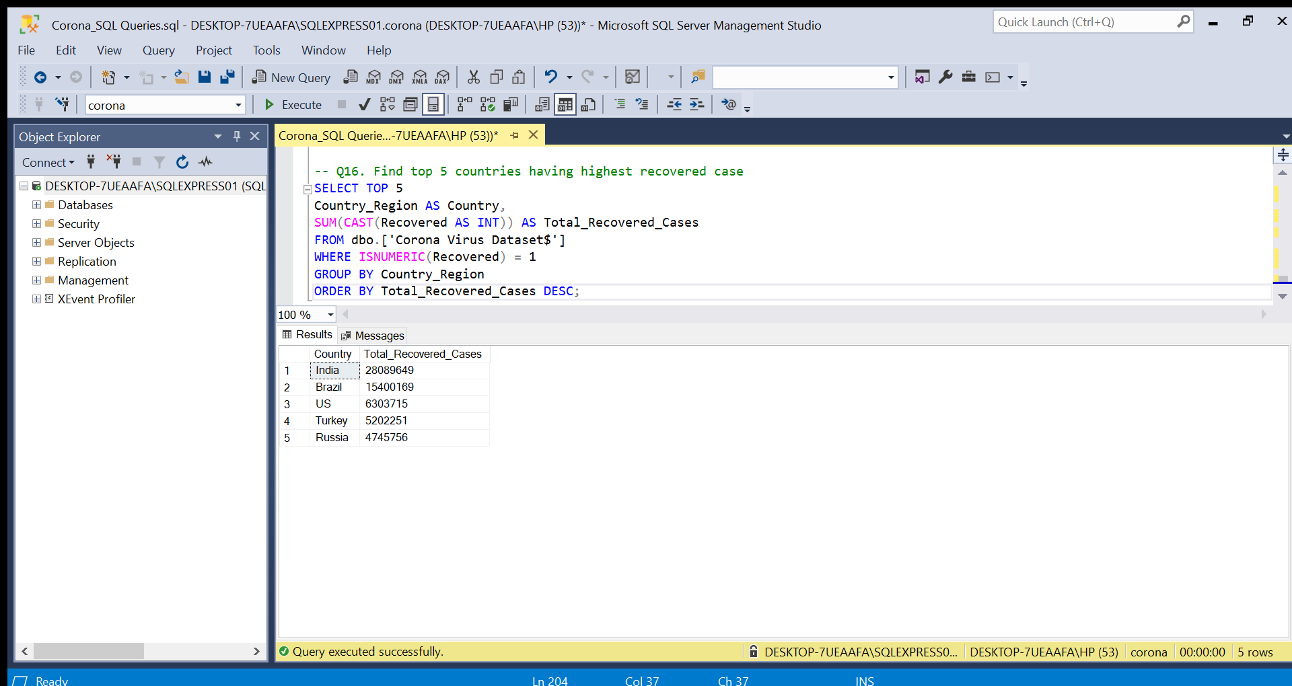
Top 5 Countries Having Highest Recovered Case

Slide 21
INSIGHTS
The SQL Analysis showed the country with the highest and lowest cases of Deaths, Recovered, Confirmed.
1. There are no null values as clearly seen after carrying out data cleaning.
2. The CORONA VIRUS dataset covers COVID-19 Pandemic in the year 22nd January, 2020 to 13th June, 2021. with total records of 78386 rows.
3. The top 5 countries having highest recovered cases are; India, Brazil, US, Turkey and Russia. This indicates a good level of treatments and healthcare working systems.
4. The country having highest number of the Confirmed case is US with the highest number of 33461982.

Slide 22
CONCLUSION
Microsoft SQL Server Management Studio was used to carry out data exploration which enabled me to query and analyze the COVID-19 pandemic dataset. Thereby revealing meaningful insights that will be helpful to healthcare systems to prepare and curb the viruses in the future.

Slide 23
THANK YOU

